Slide 1
Operating System
Lecture 16: File System Implementation
Manoj Kumar Jain
M.L. Sukhadia University Udaipur

Slide 2
Outline
File System Structure
File System Implementation
Directory Implementation
Allocation Methods
Free-Space Management
Efficiency and Performance
Manoj Kumar Jain Professor Computer Science MLSU Udaipur

Slide 3
File-System Structure
File structure
  Logical storage unit
  Collection of related information
File system resides on secondary storage (disks).
File system organized into layers.
File control block – storage structure consisting of information about a file.
Manoj Kumar Jain Professor Computer Science MLSU Udaipur

Slide 4

Layered File System
Manoj Kumar Jain Professor Computer Science MLSU Udaipur

Slide 5

A Typical File Control Block
Manoj Kumar Jain Professor Computer Science MLSU Udaipur

Slide 6
In-Memory File System Structures
The following figure illustrates the necessary file system structures provided by the operating systems.
Figure 12-3(a) refers to opening a file.
Figure 12-3(b) refers to reading a file.
Manoj Kumar Jain Professor Computer Science MLSU Udaipur

Slide 7

In-Memory File System Structures
Manoj Kumar Jain Professor Computer Science MLSU Udaipur

Slide 8
Virtual File Systems
Virtual File Systems (VFS) provide an object-oriented way of implementing file systems.
VFS allows the same system call interface (the API) to be used for different types of file systems.
The API is to the VFS interface, rather than any specific type of file system.
Manoj Kumar Jain Professor Computer Science MLSU Udaipur

Slide 9
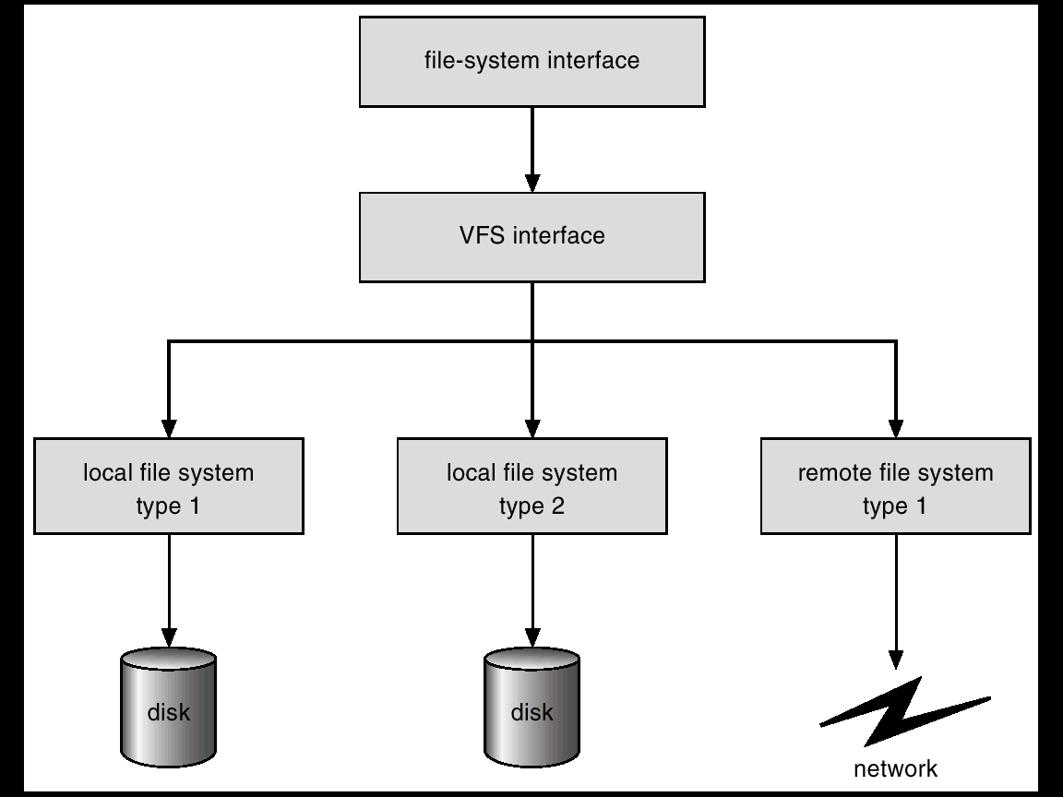
Schematic View of Virtual File System
Manoj Kumar Jain Professor Computer Science MLSU Udaipur

Slide 10
Directory Implementation
Linear list of file names with pointer to the data blocks.
  simple to program
  time-consuming to execute
Hash Table – linear list with hash data structure.
  decreases directory search time
  collisions – situations where two file names hash to the same location
  fixed size
Manoj Kumar Jain Professor Computer Science MLSU Udaipur

Slide 11
Allocation Methods
An allocation method refers to how disk blocks are allocated for files:
Contiguous allocation
Linked allocation
Indexed allocation
Manoj Kumar Jain Professor Computer Science MLSU Udaipur

Slide 12
Contiguous Allocation
Each file occupies a set of contiguous blocks on the disk.
Simple – only starting location (block #) and length (number of blocks) are required.
Random access.
Wasteful of space (dynamic storage-allocation problem).
Files cannot grow.
Manoj Kumar Jain Professor Computer Science MLSU Udaipur

Slide 13

Contiguous Allocation of Disk Space
Manoj Kumar Jain Professor Computer Science MLSU Udaipur

Slide 14
Extent-Based Systems
Many newer file systems (I.e. Veritas File System) use a modified contiguous allocation scheme.
Extent-based file systems allocate disk blocks in extents.
An extent is a contiguous block of disks. Extents are allocated for file allocation. A file consists of one or more extents.
Manoj Kumar Jain Professor Computer Science MLSU Udaipur

Slide 15
Linked Allocation
Each file is a linked list of disk blocks: blocks may be scattered anywhere on the disk.
block =
pointer
Manoj Kumar Jain Professor Computer Science MLSU Udaipur

Slide 16
Linked Allocation (Cont.)
Simple – need only starting address
Free-space management system – no waste of space
No random access
Mapping
Q
LA/511
R
  Block to be accessed is the Qth block in the linked chain of blocks representing the file.
  Displacement into block = R + 1
File-allocation table (FAT) – disk-space allocation used by MS-DOS and OS/2.
Manoj Kumar Jain Professor Computer Science MLSU Udaipur

Slide 17

Linked Allocation
Manoj Kumar Jain Professor Computer Science MLSU Udaipur

Slide 18

File-Allocation Table
Manoj Kumar Jain Professor Computer Science MLSU Udaipur

Slide 19
Indexed Allocation
Brings all pointers together into the index block.
Logical view.
index table
Manoj Kumar Jain Professor Computer Science MLSU Udaipur

Slide 20

Example of Indexed Allocation
Manoj Kumar Jain Professor Computer Science MLSU Udaipur

Slide 21
Indexed Allocation (Cont.)
Need index table
Random access
Dynamic access without external fragmentation, but have overhead of index block.
Mapping from logical to physical in a file of maximum size of 256K words and block size of 512 words. We need only 1 block for index table.
Q
LA/512
R
Q = displacement into index table
R = displacement into block
Manoj Kumar Jain Professor Computer Science MLSU Udaipur

Slide 22
Indexed Allocation – Mapping (Cont.)
Mapping from logical to physical in a file of unbounded length (block size of 512 words).
Linked scheme – Link blocks of index table (no limit on size).
Q₁
LA / (512 x 511)
R₁
  Q₁ = block of index table
  R₁ is used as follows:
Q₂
R₁ / 512
R₂
  Q₂ = displacement into block of index table
  R₂ displacement into block of file:
Manoj Kumar Jain Professor Computer Science MLSU Udaipur

Slide 23
Indexed Allocation – Mapping (Cont.)
Two-level index (maximum file size is 512³)
Q₁
LA / (512 x 512)
R₁
  Q₁ = displacement into outer-index
  R₁ is used as follows:
Q₂
R₁ / 512
R₂
  Q₂ = displacement into block of index table
  R₂ displacement into block of file:
Manoj Kumar Jain Professor Computer Science MLSU Udaipur

Slide 24
Indexed Allocation – Mapping (Cont.)

outer-index
index table
file
Manoj Kumar Jain Professor Computer Science MLSU Udaipur

Slide 25

Combined Scheme: UNIX (4K bytes per block)
Manoj Kumar Jain Professor Computer Science MLSU Udaipur

Slide 26
Free-Space Management
Bit vector (n blocks)
0
1
2
n-1
…
0 ⇒ block[i] free
1 ⇒ block[i] occupied
bit[i] =

Block number calculation
(number of bits per word) *
(number of 0-value words) +
offset of first 1 bit
Manoj Kumar Jain Professor Computer Science MLSU Udaipur

Slide 27
Free-Space Management (Cont.)
Bit map requires extra space. Example:
block size = 2¹² bytes
disk size = 2³⁰ bytes (1 gigabyte)
n = 2³⁰/2¹² = 2¹⁸ bits (or 32K bytes)
Easy to get contiguous files
Linked list (free list)
  Cannot get contiguous space easily
  No waste of space
Grouping
Counting
Manoj Kumar Jain Professor Computer Science MLSU Udaipur

Slide 28
Free-Space Management (Cont.)
Need to protect:
  Pointer to free list
  Bit map
    Must be kept on disk
    Copy in memory and disk may differ.
    Cannot allow for block[i] to have a situation where bit[i] = 1 in memory and bit[i] = 0 on disk.
  Solution:
    Set bit[i] = 1 in disk.
    Allocate block[i]
    Set bit[i] = 1 in memory
Manoj Kumar Jain Professor Computer Science MLSU Udaipur

Slide 29

Linked Free Space List on Disk
Manoj Kumar Jain Professor Computer Science MLSU Udaipur

Slide 30
Efficiency and Performance
Efficiency dependent on:
  disk allocation and directory algorithms
  types of data kept in file’s directory entry
Performance
  disk cache – separate section of main memory for frequently used blocks
  free-behind and read-ahead – techniques to optimize sequential access
  improve PC performance by dedicating section of memory as virtual disk, or RAM disk.
Manoj Kumar Jain Professor Computer Science MLSU Udaipur

Slide 31

Various Disk-Caching Locations
Manoj Kumar Jain Professor Computer Science MLSU Udaipur

Slide 32
Page Cache
A page cache caches pages rather than disk blocks using virtual memory techniques.
Memory-mapped I/O uses a page cache.
Routine I/O through the file system uses the buffer (disk) cache.
This leads to the following figure.
Manoj Kumar Jain Professor Computer Science MLSU Udaipur

Slide 33
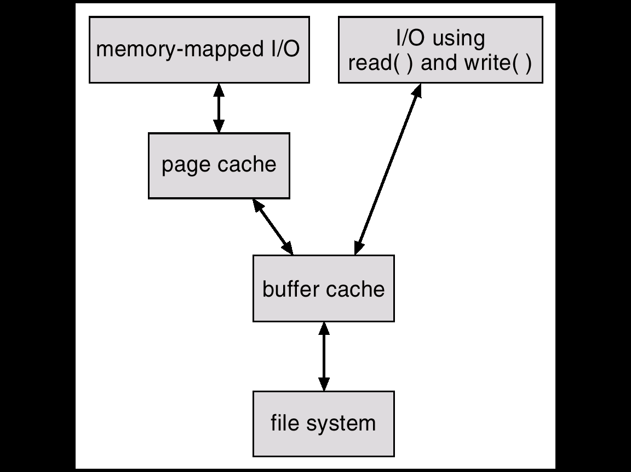
I/O Without a Unified Buffer Cache
Manoj Kumar Jain Professor Computer Science MLSU Udaipur

Slide 34
Unified Buffer Cache
A unified buffer cache uses the same page cache to cache both memory-mapped pages and ordinary file system I/O.
Manoj Kumar Jain Professor Computer Science MLSU Udaipur

Slide 35
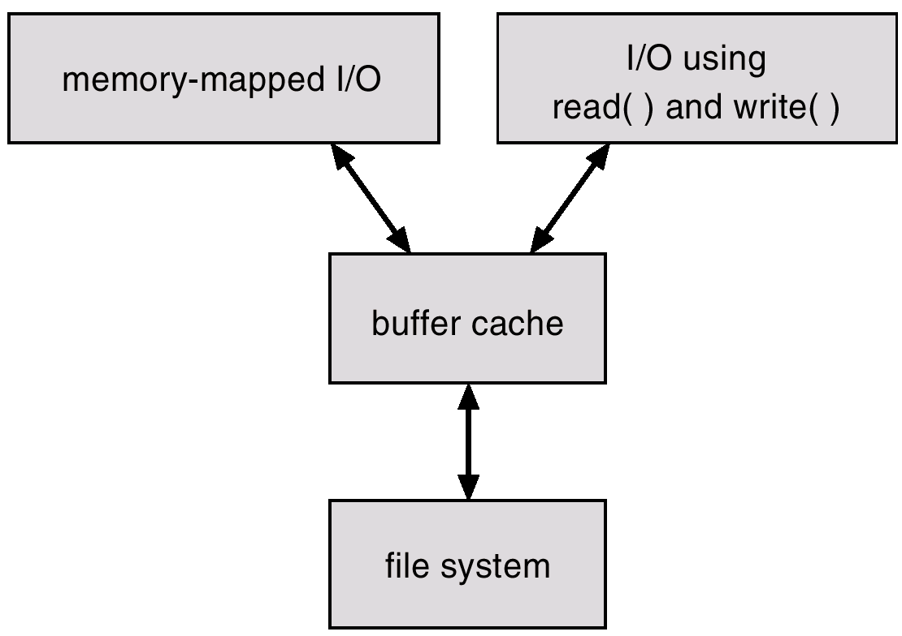
I/O Using a Unified Buffer Cache
Manoj Kumar Jain Professor Computer Science MLSU Udaipur

Slide 36
Thanks
Manoj Kumar Jain Professor Computer Science MLSU Udaipur

